Slide 1
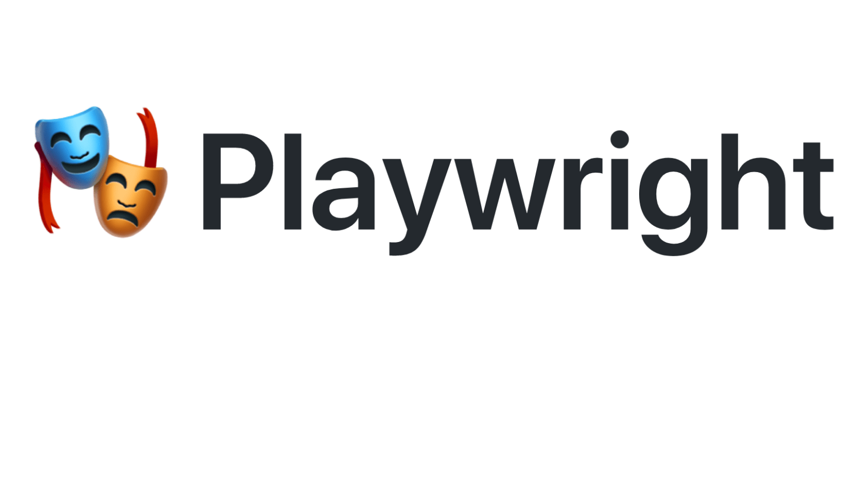


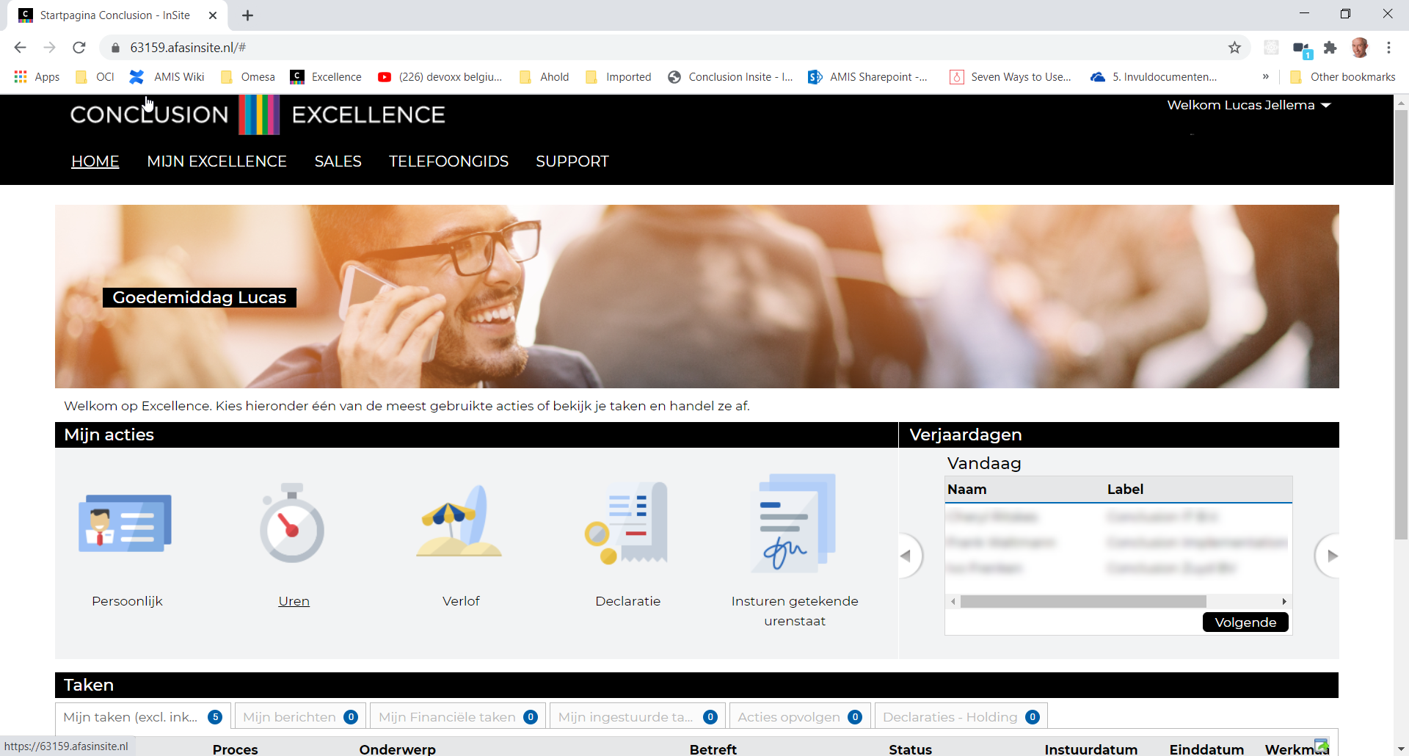



Playwright Automation of browser interaction
2021
Lucas Jellema, CTO & Architect AMIS | Conclusion
sources: github.com/lucasjellema/playwright-scenarios

Slide 2
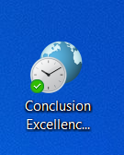
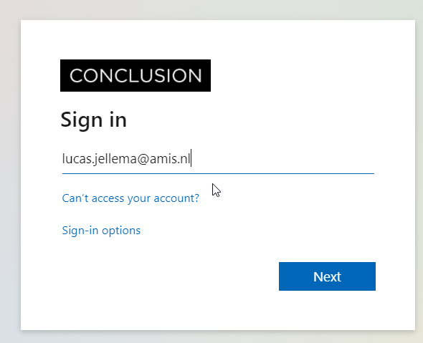
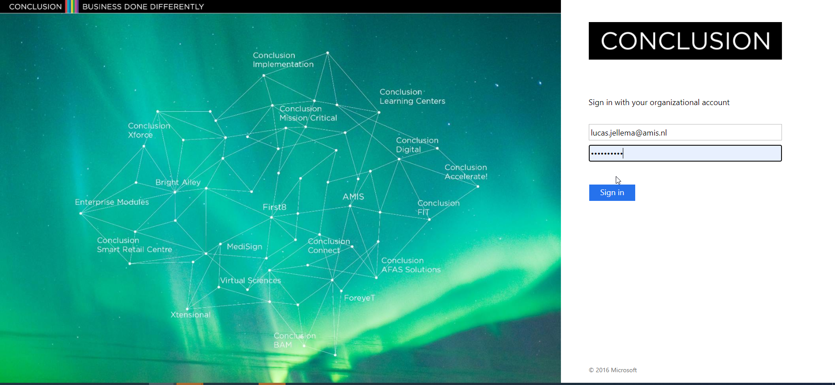
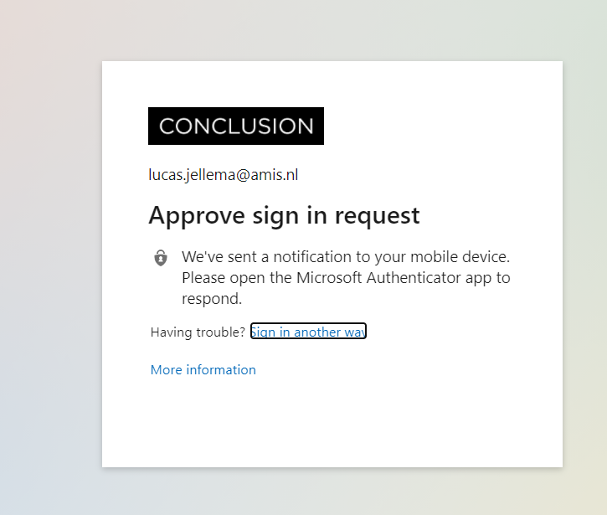
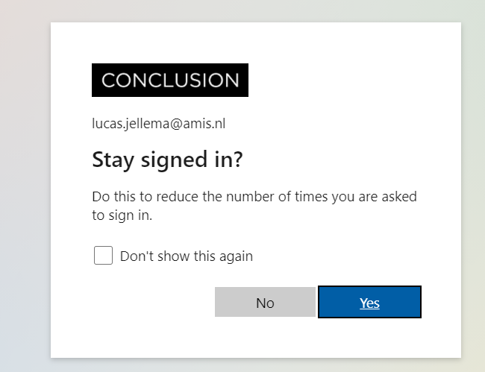
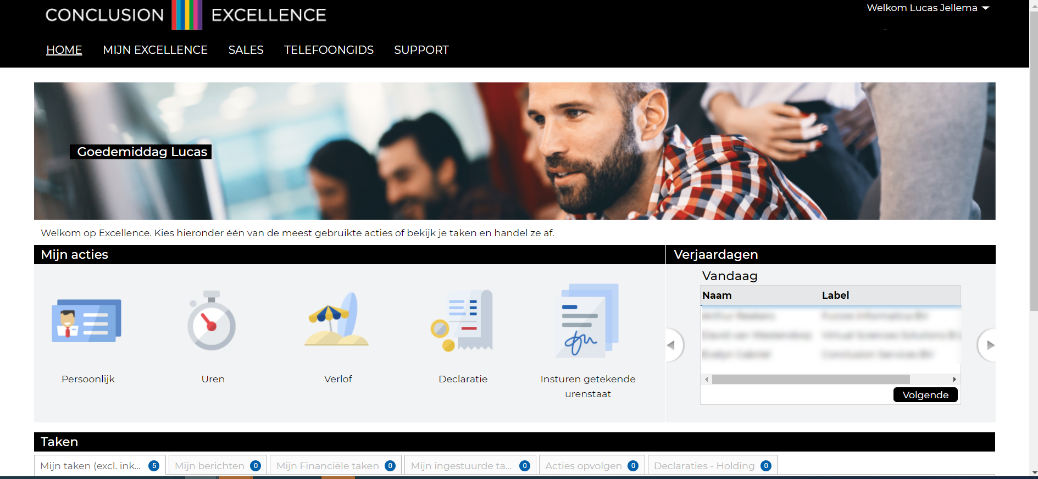
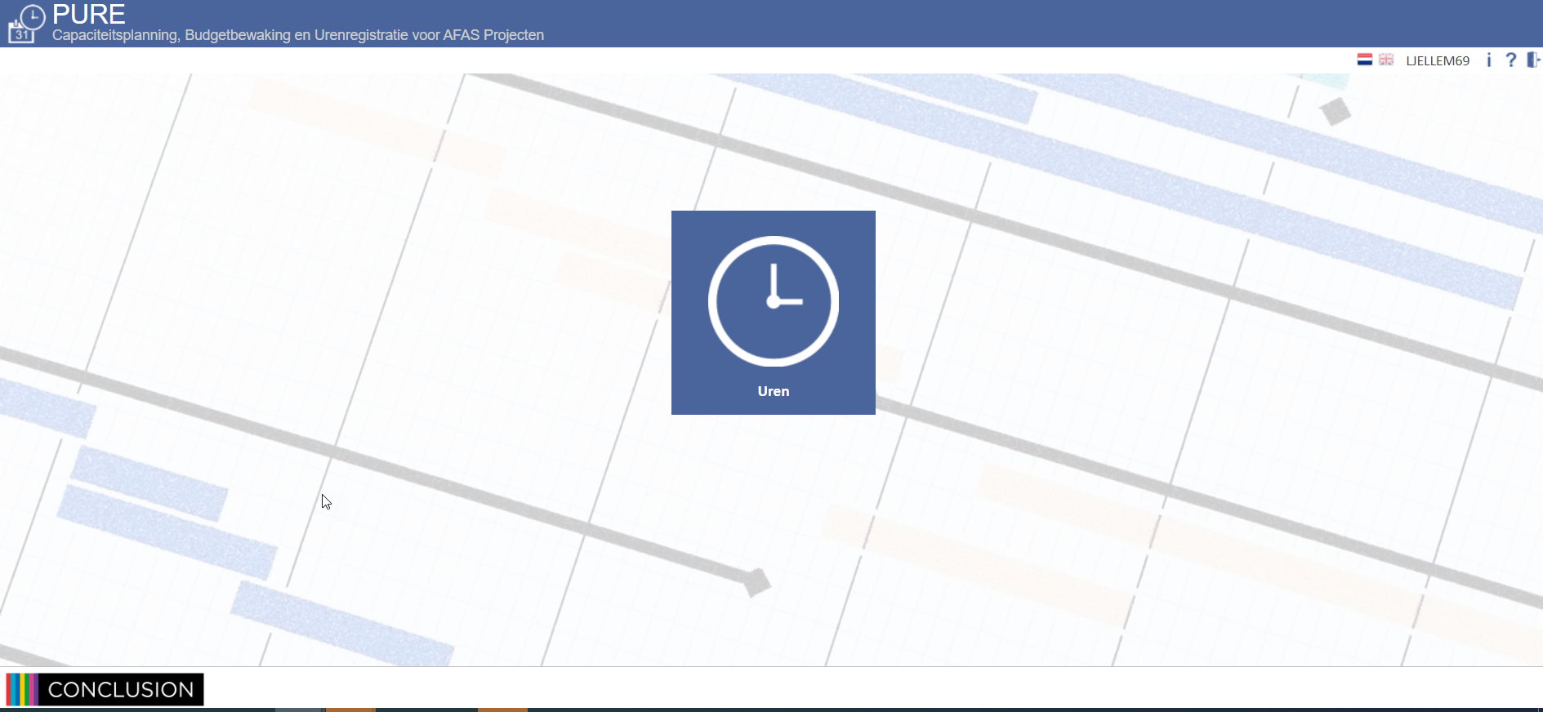
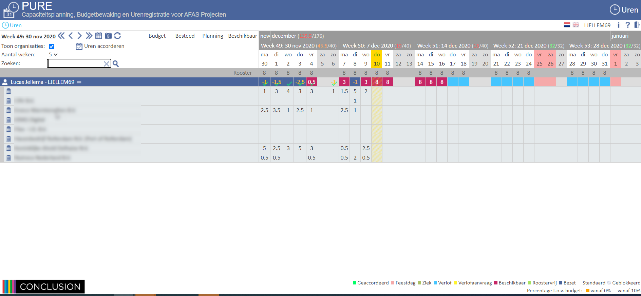
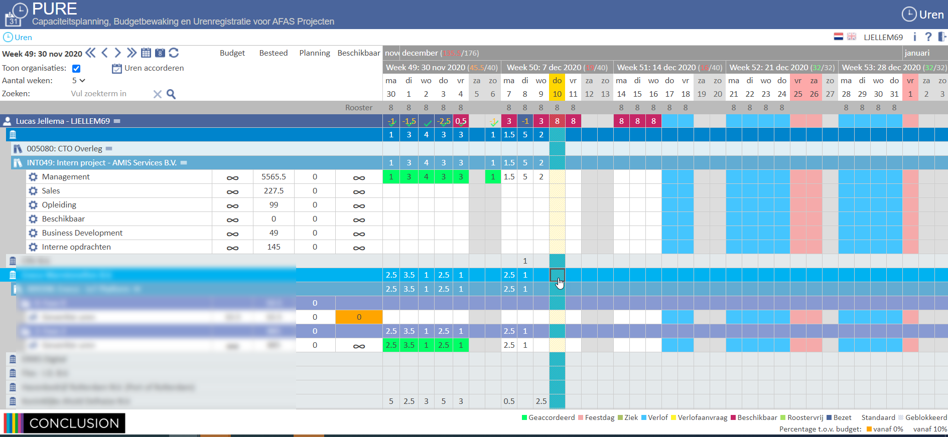
Demo – Timesheet Deeplink Bookmark
Manually
Deeplink Bookmark
Open browser
Navigate to page
Login
<MFA approval on mobile phone>
Confirm popup
Click on navigation button
<new frame opens>
Click on navigation button
<timesheet opens>
Expand Project
<wait>
Expand Project
<wait>
…
Start entering hours
Click on Shortcut
<MFA approval on mobile phone>
<wait>
Start entering hours

Slide 3
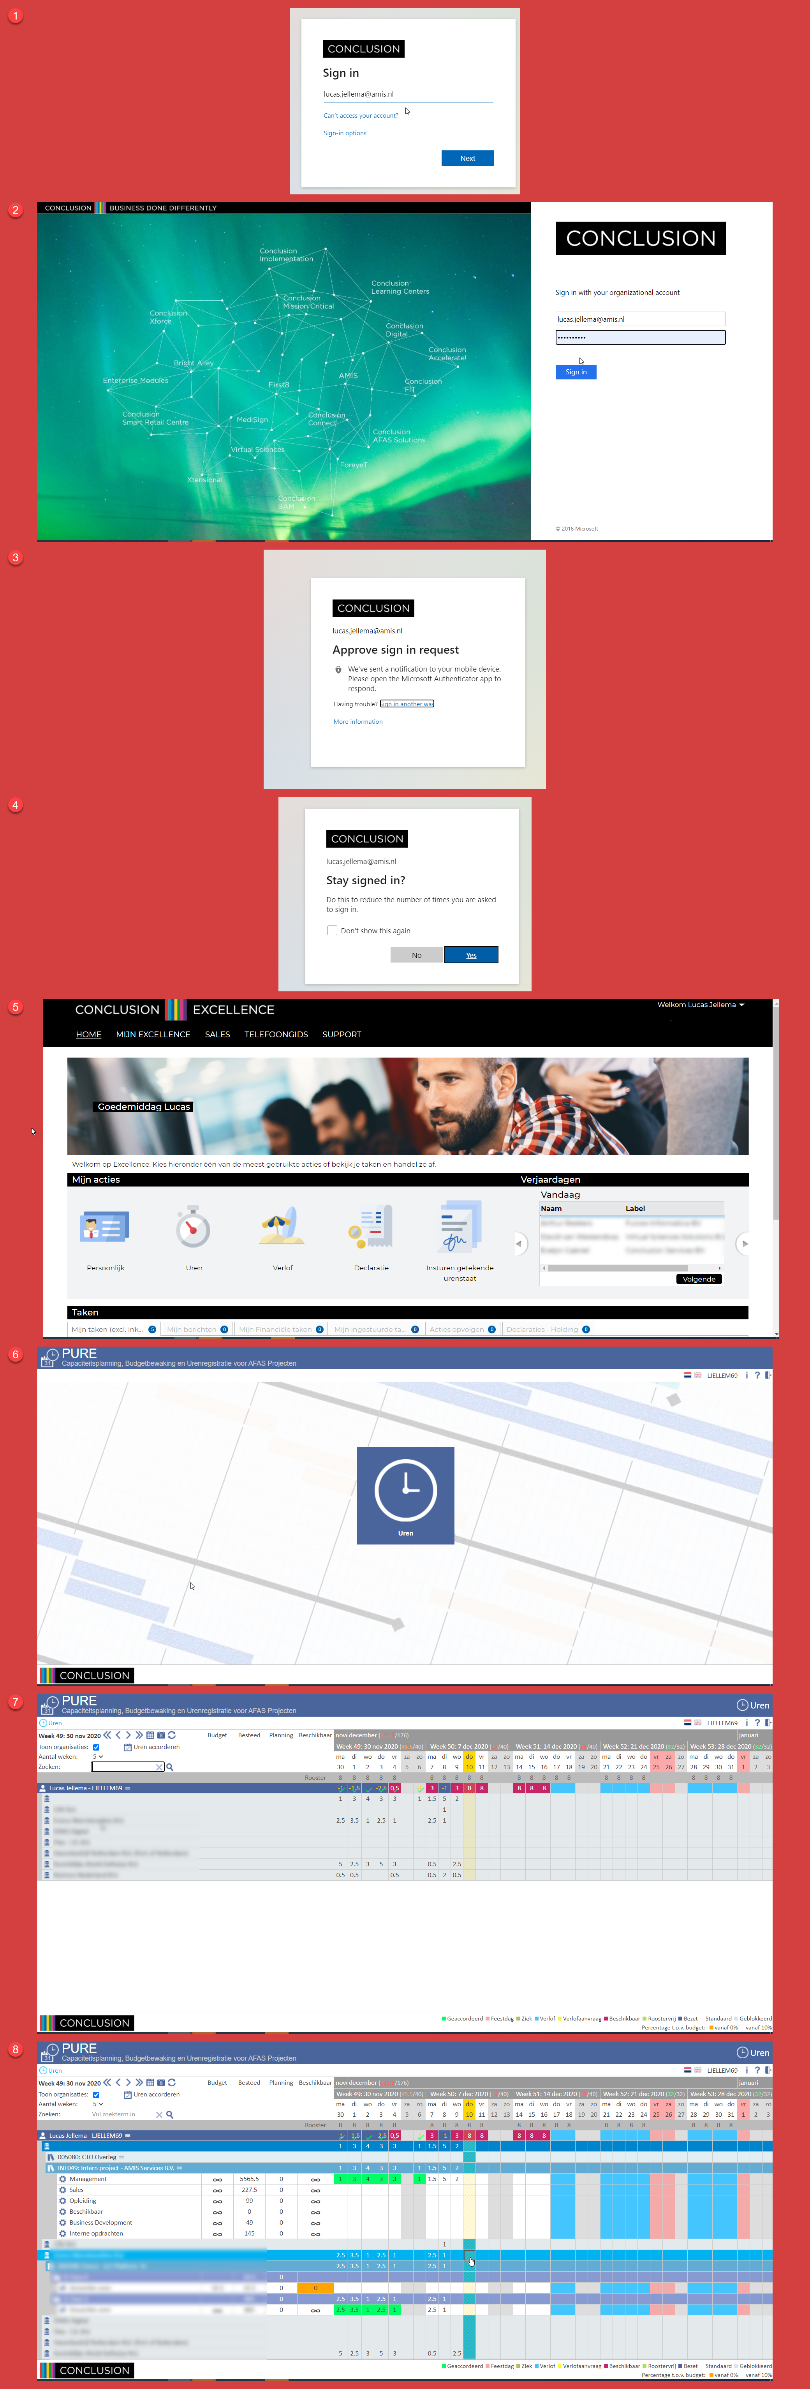


Deep Link Bookmark – Under the Hood

Slide 4

Playwright – a robot-in-a-browser

Slide 5
Playwright – a robot-in-a-browser
HTTP Requests to fetch HTML, CSS, JS, images, JSON, SVG, XML, SSE, files, …
My Custom Application
Web Application
HTTP Requests to post data, upload files, …
DOM, JavaScript context, web workers, local storage, cookies,

Slide 6
Playwright – a robot-in-a-browser
HTTP Requests to fetch HTML, CSS, JS, images, JSON, SVG, XML, SSE, files, …
Read DOM elements, fill in fields, click buttons, trigger events, manipulate/add DOM elements, add and execute JavaScript
My Custom Application
Web Application
HTTP Requests to post data, upload files, …
DOM, JavaScript context, web workers, local storage, cookies,

Slide 7
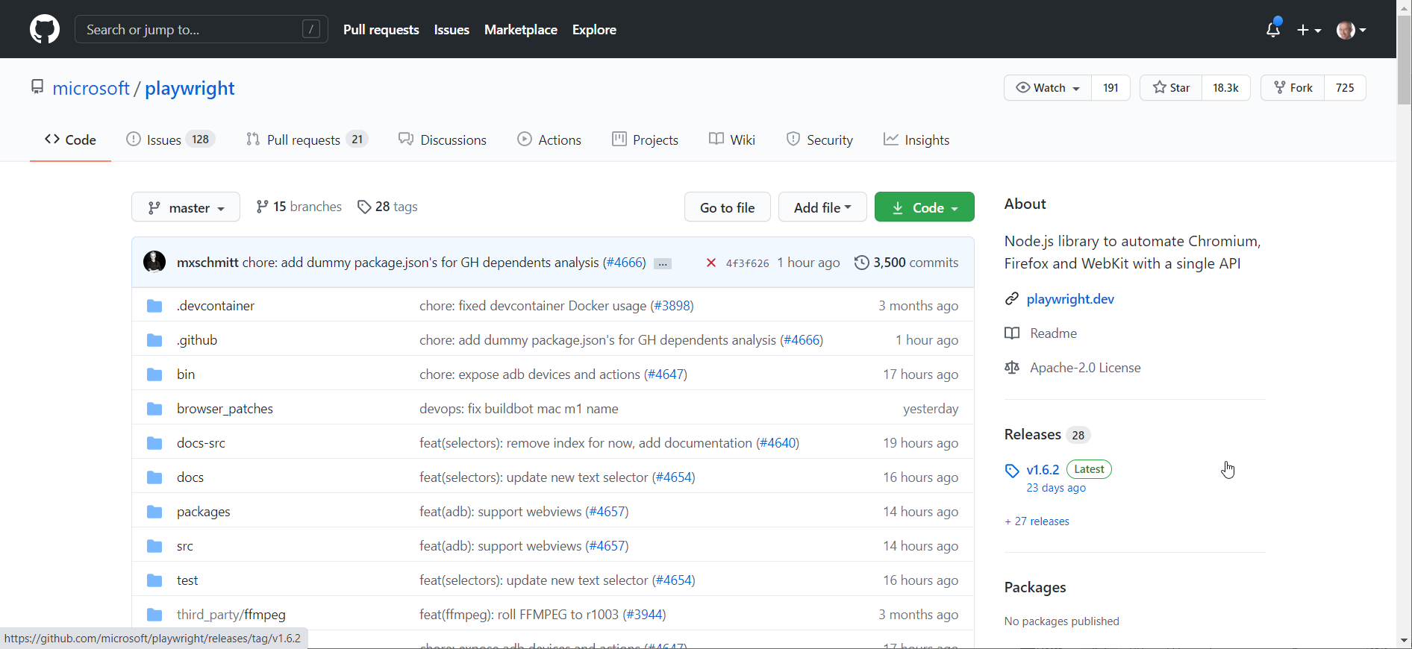
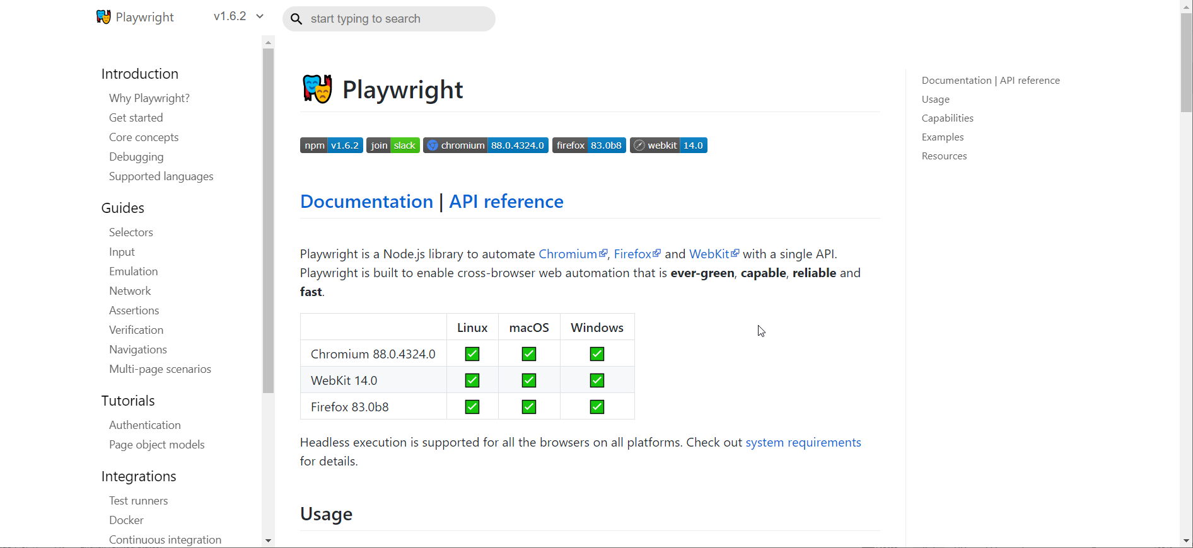
History of Playwright
First release January 2020
By Microsoft - the team that first created Puppeteer (while working at Google)
Open Source – on GitHub
Support for Chromium, Firefox and WebKit
Is an alternative to WebDriver
The Playwright API is available for
JavaScript and TypeScript
Python
C#
Go
Docker Container to running Playwright scripts: mcr.microsoft.com/playwright:bionic
Homepage: playwright.dev

Slide 8
Hello World of Playwright Demos
//navigate to whatsmyuseragent.org and take a screenshot.
const { chromium } = require('playwright’);
(async () => {
// start headless embedded browser
const browser = await chromium.launch({headless: true});
const page = await browser.newPage();
// navigate to thesite
await page.goto('http://whatsmyuseragent.org/');
await page.screenshot({ path: `example.png` });
await browser.close();
})();

Slide 9

Many Opportunities Open Up
Deeplink Bookmarks
UI Test automation
including visual regression (use Resemble.js, pixelmatch, Rembrandt.js)
behavior driven testing
Tactical integration
automation of data retrieval (“Screen Scraping”)
and data entry
Health Checks (monitoring of User Interfaces)
Automated Reporting
Customized Web Application (vanity UI)
UI turned API
Demos and [step by step] Instructions
RPA – Robotic Process Automation
automated workflow across multiple systems
possibly a collaboration between human & robot

Slide 10

UI as API
Web Application
API

Slide 11
UI as API
Web Application
API

Slide 12
Google Translate UI published as API
Translation API to easily translate a text from source to target language
Web Application
API

Slide 13
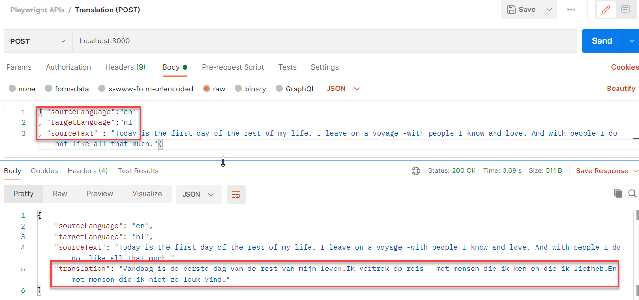
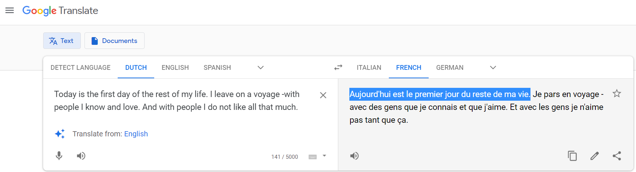
Google Translate UI published as API
Web Application
API

Slide 14
Demo of Translation API (powered by Google Translate)
const translate = async (sourceText, sourceLanguage, targetLanguage) => {
const browser = await chromium.launch({ headless: true })
const context = await browser.newContext()
const page = await context.newPage()
const navigationPromise = page.waitForNavigation()
await page.goto(`https://translate.google.com/?sl=${sourceLanguage}&tl=${targetLanguage}`)
await navigationPromise
await page.waitForSelector('textarea')
}

Slide 15
Demo of Translation API (powered by Google Translate)
const translate = async (sourceText, sourceLanguage, targetLanguage) => {
const browser = await chromium.launch({ headless: true })
const context = await browser.newContext()
const page = await context.newPage()
const navigationPromise = page.waitForNavigation()
await page.goto(`https://translate.google.com/?sl=${sourceLanguage}&tl=${targetLanguage}`)
await navigationPromise
await page.waitForSelector('textarea')
// set text to translate in the source textarea; note: if length of sourceText > 5000, // then we should process the sourceText in multiple (parallel processed) slices
await page.fill('textarea', sourceText);
// give Google Translate a little time to perform the translation
await sleep(800)
// get translations from target area (which consists of one or more spans): '.VIiyi > span > span'
const translatedLines = await page.$$eval(".VIiyi > span > span", (spans) => {
return spans.map(span => span.innerText); });
// concatenate the individual lines to a single string
const translation = translatedLines.reduce((accumulator, line) => accumulator + line)
await browser.close()
return translation
}

Slide 16

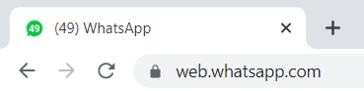
Programmatic interaction with WhatsApp
send message to contact
Web Application
API

Slide 17
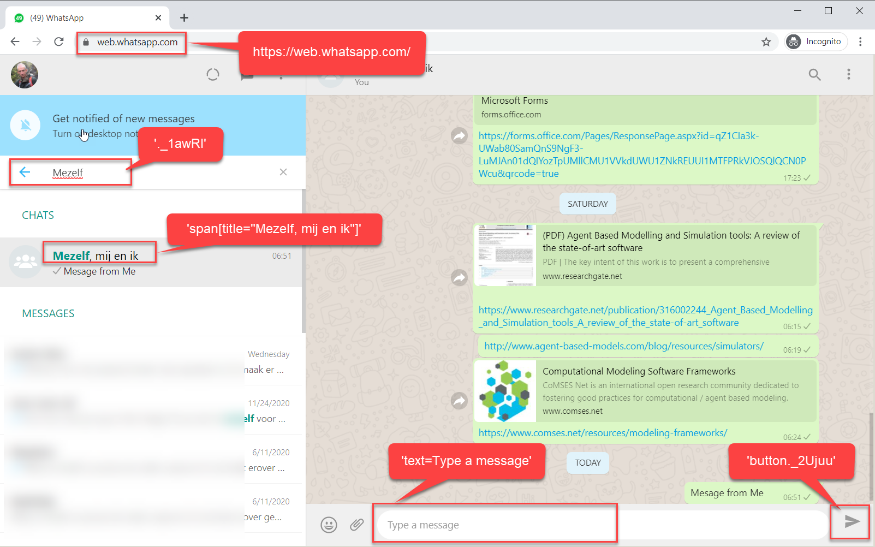
Whats App Web interface

Slide 18
Send Message to WhatsApp Contact
const { chromium } = require('playwright');
const { trapEventsOnPage } = require("../playwrightHelper");
const WHATSAPP_WEB_URL = "https://web.whatsapp.com/"
const whatsappContact = "Mezelf, mij en ik"
const message = "My message from the WhatsApp robot"
(async () => {
const browser = await chromium.launch({ headless: false })
const context = await browser.newContext()
const page = await context.newPage();
await page.goto(WHATSAPP_WEB_URL); // at this point: scan QR code in the WhatsApp app on your phone to confirm it is you ...

Slide 19
Send Message to WhatsApp Contact
... // wait for element search box
await page.waitForSelector('._1awRl')
// enter name of contact in search box
await page.fill('._1awRl', whatsappContact);
// page filters list of contacts
await page.waitForSelector(`span[title="${whatsappContact}"]`)
// click on the contact - this refreshes the right pane with recent messages and a box for sending new messages
await page.click(`span[title="${whatsappContact}"]`)
// wait for the field to send a message
await page.waitForSelector('text=Type a message')
// type the message to send
await page.type('text=Type a message', message)
// click button to send message
await page.click('button._2Ujuu')
await browser.close()
})()

Slide 20
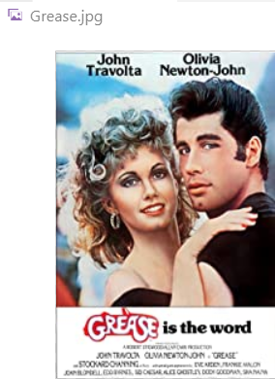
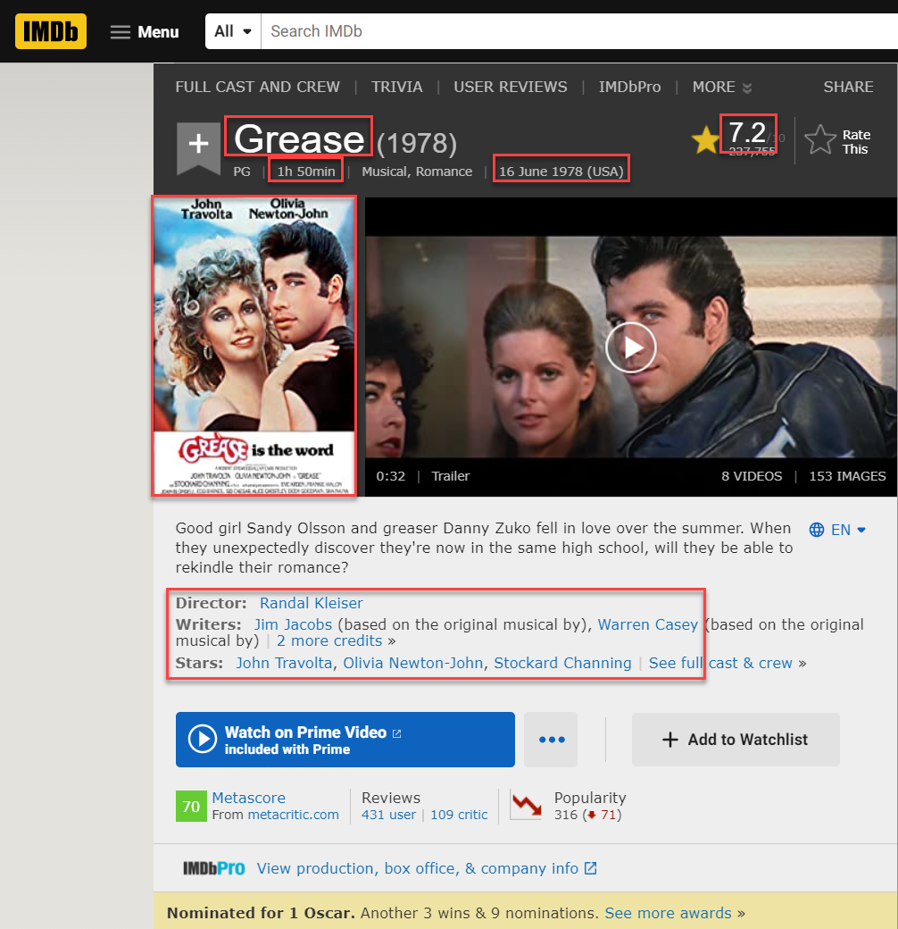
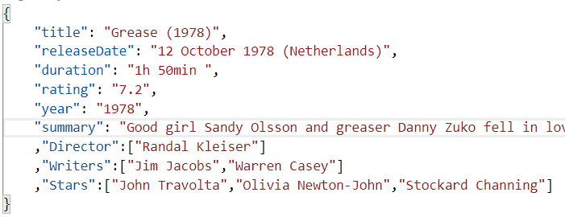
Programmatic IMDb Data Scraping
Web Application
REAL Toolshed | December 2020 | Playwright browser automation

Slide 21
Programmatic IMDb Data Scraping
REAL Toolshed | December 2020 | Playwright browser automation

Slide 22
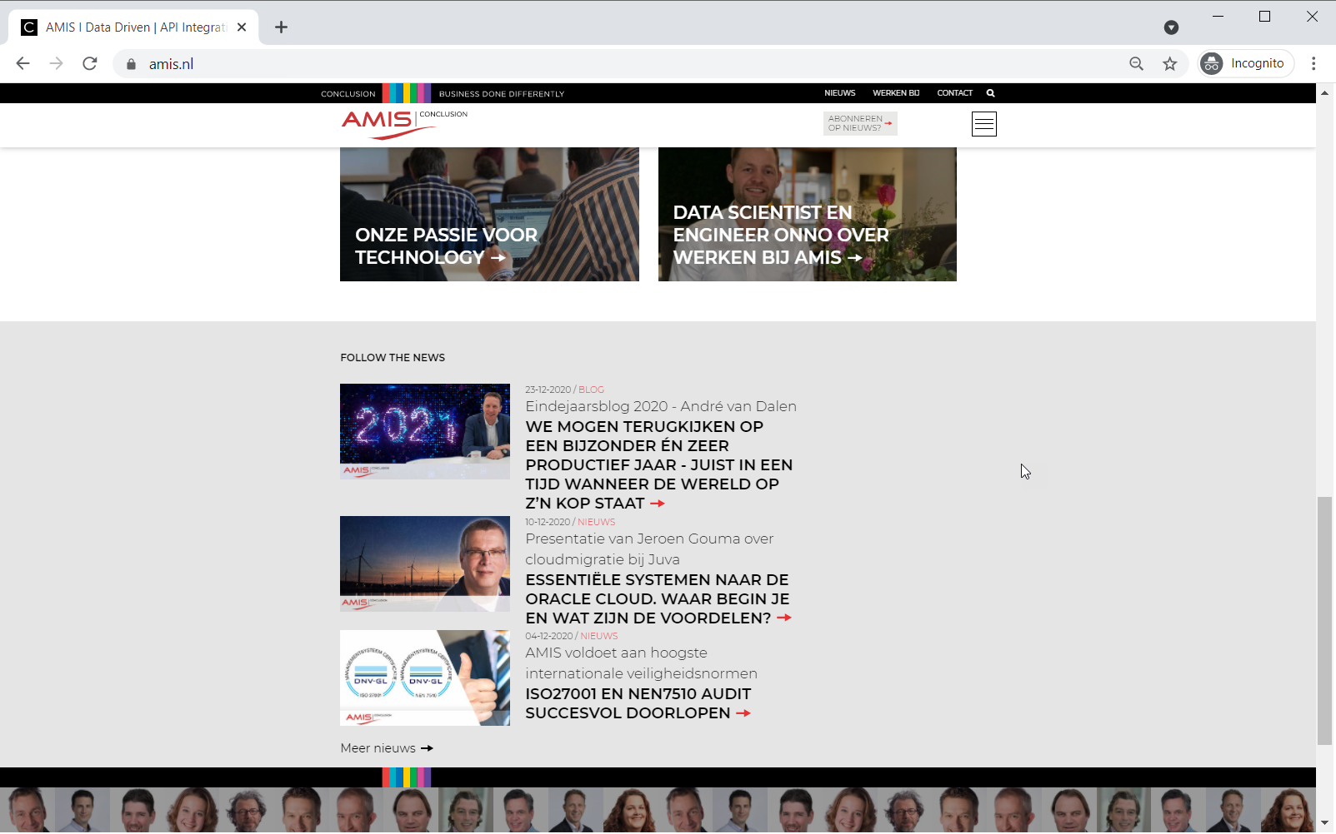
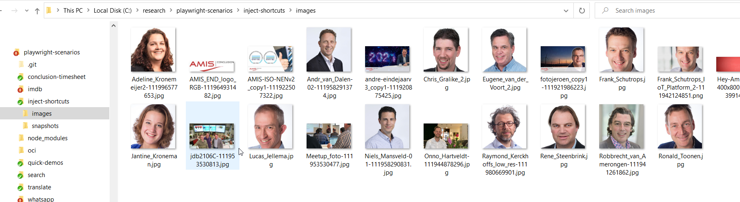
Add Short Cut Keys to Web Application Example: download all images in the current page
Get all image elements using page.$$eval; use request to fetch the image content and fs to write the image to a local file; this function is exposed in browser context as imageDownloadFunction
ctrl+b is set up as short cut key to download all images
Web Application
function allImage Downloader
function handle ShortCutKey
writes image files to local directory
Added with page.addScriptTag to the browser context. Setup as event handler for key up event and invokes window.imageDownloadFunction

Slide 23
Add Short Cut Keys to Web Application Example: download all images in the current page
ctrl+b is set up as short cut key to download all images
Web Application
function handle ShortCutKey
Added with page.addScriptTag to the browser context. Setup as event handler for key up event and invokes window.imageDownloadFunction

Slide 24
Initialize
const { chromium } = require('playwright');
const fs = require("fs");
const request = require('request') const URL = "https://www.amis.nl/"
const IMAGE_PATH = "./images/"
var streamImageFromURL = function (imageURL, imageFilename) {
request(imageURL).pipe(fs.createWriteStream(`${IMAGE_PATH}${imageFilename}`));
}
const allImageDownloader = async (source) => {
const images = await source.page.$$eval("img", (images) =>
images.map((image) => { return {src: image.src, alt: image.alt, width:image.clientWidth, height:image.clientHeight}})
)
images.forEach(image => { if (image.width * image.height > 2500) {
const startIndex = image.src.lastIndexOf("/") + 1 // do not include /
const endIndex = image.src.indexOf("?")> -1? image.src.indexOf("?"):500
const imageFilename = image.src.substring(startIndex,endIndex)
console.log(`download ${image.src} as ${imageFilename}`)
streamImageFromURL(image.src, imageFilename);
}
});
return images.length
}

Slide 25
Inject shortcut key for downloading all images into page
(async () => {
const browser = await chromium.launch({ headless: false })
const context = await browser.newContext()
// expose a Node function as binding to the page (to be invoked from the function)
await context.exposeBinding('imageDownloadFunction', allImageDownloader)
const page = await context.newPage(); await page.goto(URL);
// create a shortcut key (ctrl + b) that triggers the JS function to download all images
const shortCutJS = `async function handleShortCutKey(e) { if ('KeyB'==e.code && e.ctrlKey)
const result = await window.imageDownloadFunction() ; }
document.addEventListener('keyup', handleShortCutKey);
`
// add shortCutJS as script tag to the page; this instantly creates a function and // registers it as event handler await page.addScriptTag({ content: shortCutJS }) ... // at this point, the browser will respond to ctrl+b by invoking handleShortCutKey // that in turn invokes imageDownloadFunction() which is in fact function allImageDownloader in // the context of the Node application; this function gets hold of all IMG elements in the page // and downloads their contents

Slide 26
Add Short Cut Keys to Web Application Example: take snapshot of the current page
Expose NodeJS function as JavaScript function [proxy] in the browser context of the web page
Add keyup event listener to invoke this proxy when the shortcut key (ctrl + y) is pressed
Web Application
function snapshotter
function snapshotterFunction
This function is handed a Playwright source object that contains a reference to the page object. The screenshot() function on this object is invoked to write a PNG file with a snapshot of the current browser’s page content

Slide 27
Inject shortcut key for downloading all images into page
let snapshotCount = 0
const snapshotter = async (source) => {
await source.page.screenshot({ path: `${SNAPSHOT_PATH}pageSnapshot${snapshotCount++}.png` });
}
// create a shortcut key (ctrl + b) that triggers the JS function to download all images
const shortCutJS = `async function handleShortCutKey(e) { if ('KeyY'==e.code && e.ctrlKey) {
window.snapshotFunction() ; }}
document.addEventListener('keyup', handleShortCutKey);
`
(async () => {
const browser = await chromium.launch({ headless: false })
const context = await browser.newContext()
// expose a Node function as binding to the page (to be invoked from the function)
await context.exposeBinding('snapshotFunction', snapshotter)
// execute JS snippet for every new page, page reload and navigation await await context.addInitScript ({ content: shortCutJS })
const page = await context.newPage(); await page.goto(URL);
... // at this point, the browser will respond to ctrl+y by invoking handleShortCutKey // that in turn invokes window.snapshotFunction() which is a proxy for function snapshotterin // the context of the Node application that will write a snapshot PNG file

Slide 28
Features
Headless and Headful
Bi-directional JavaScript interaction: from Node to Browser and from Browser to Node context (write to console within the browser or in Node)
Download and Upload Files
Get images (and write to file)
Create Screenshots (.png and PDF)
Record Playwright Session as Video (MP4)
Access to WebPerformance APIs
Social Login (Google, Microsoft Live)
but not 2FA or Captcha
Read and Set Cookies and Local Storage, interact with Web Workers,
Manipulating network requests (HTTP requests sent from the page)
Headless Recorder (browser plugin and QA Wolf) to record Playwright scripts
Make the browser do anything a user can make the browser do and everything a developer injecting JavaScript into a live session can activate
Notes:
https://dev.to/mxschmitt/using-jest-with-playwright-40lh

Slide 29

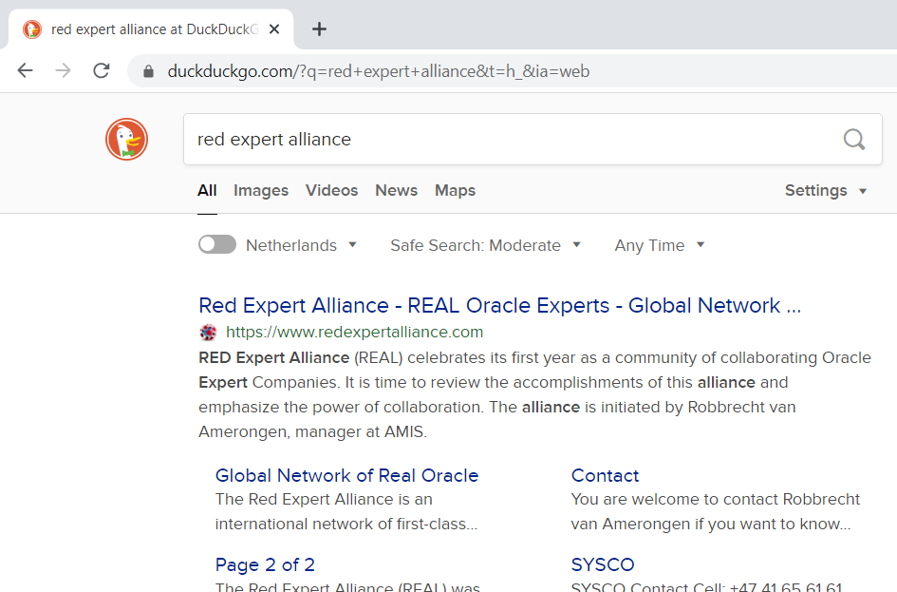
Customised UI

Slide 30
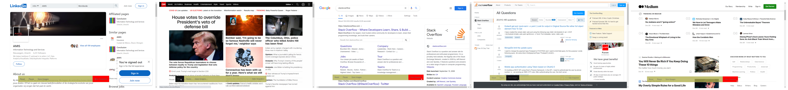

Inject Toolbar into any Web Page or Site loaded into Playwright embedded browser
Add floating toolbar with menu options to page after loading or refreshing
toolbar can be toggled on or off with shortcut key
options include Save all Images in page (to local file) and take Snapshot of page
github.com/lucasjellema/playwright-scenarios/tree/main/floating_menu

Slide 31
Implementation challenges
Create a floating, fixed, semi-transparent toolbar — using HTML and CSS
Add this toolbar — using Playwright — on top of a site or app that is loaded into the embedded browser
and ensure that the toolbar stays around / is added agan whenever the browser is navigated to a new page
Implement the Snapshot function linked to a toolbar option: when the option is triggered, the Playwright function for taking a snapshot of the page is activated.
note: the toolbar itself should be hidden at the time of taking the snapshot
Show and hide the toolbar using a short cut key combination
Add a toolbar option for saving all images in a page
Add other features to the toolbar that make life easier around specific or generic web sites and web applications
save/restore form entries, record currently selected text, remove all images from page, play a specific Playwright scenario (demo, instruction, shortcut), ...
Notes:
https://github.com/lucasjellema/playwright-scenarios/tree/main/floating_menu

Slide 32
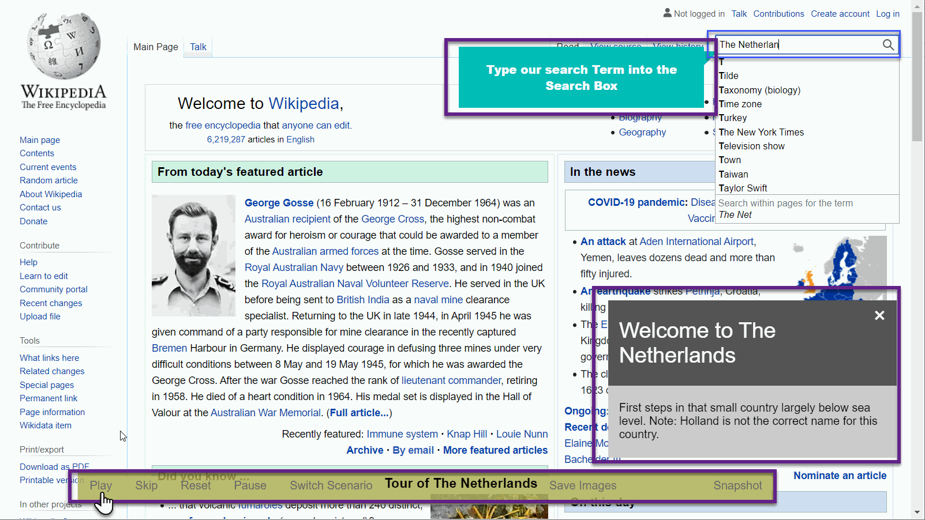
Play step-by-step headful Playwright Scenario Acts To instruct, demonstrate, collaborate or accelerate
A Playwright scenario in a headful browser can be used to
demonstrate actions in a web site or app
provide a tutorial or hands-on instruction on the site or app
perform quick actions on behalf of the user in a web site or app
create a combined human ⬄ machine workflow
Playwright script sections (command bundles) can be played on demand
with annotation
conditionally
lightning fast or at human interpretation speed

Slide 33
Playwright scenarios – tutorial | demo | documentation | …
Scenario
Play Act
Switch
Pause
Reset
Callout
In Situ Balloon help

Slide 34

Demonstration of Automated Scenario Orchestration

Slide 35
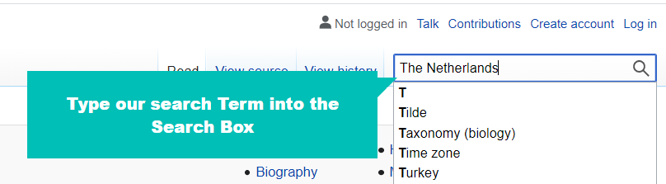
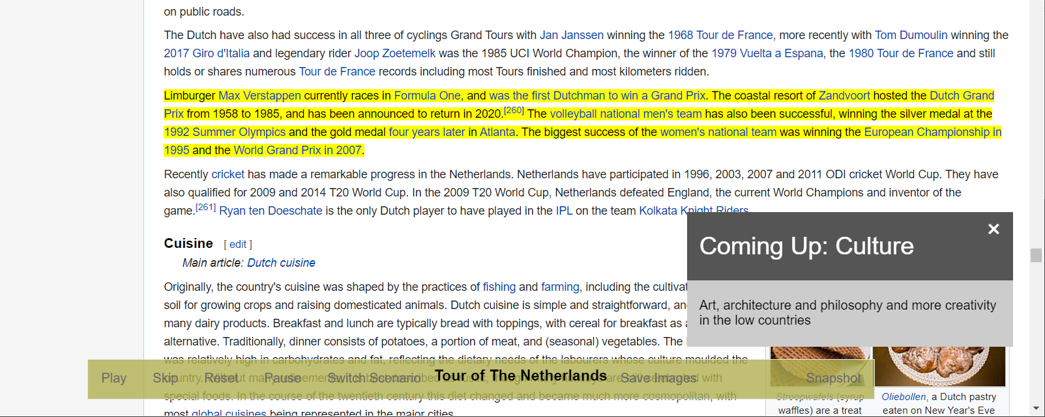
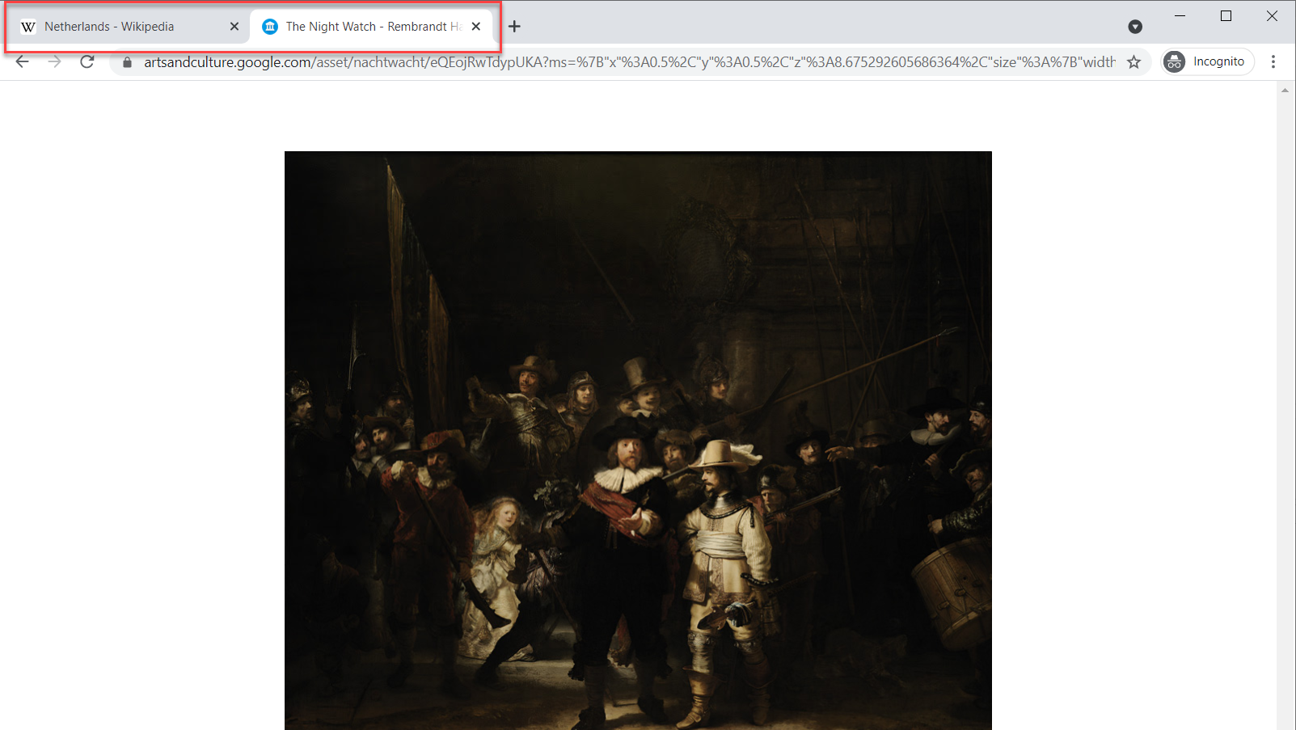
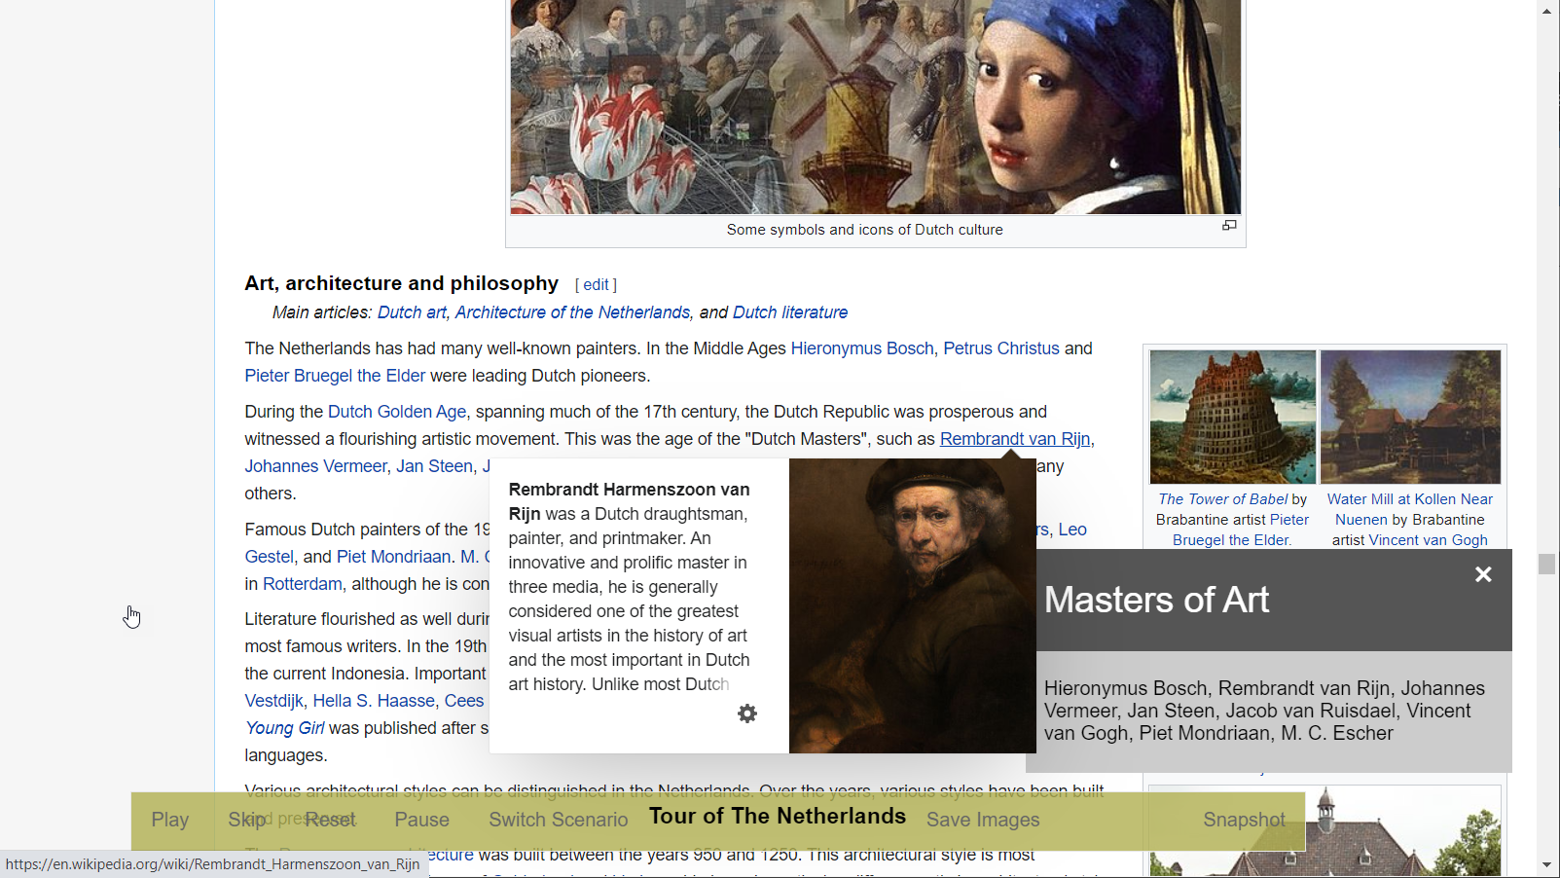
Playwright scenarios – some tricks up the sleeves of the actions
Type text
Select text
Scroll elements in view
Hover over elements
Open new tab / Switch between tabs

Slide 36
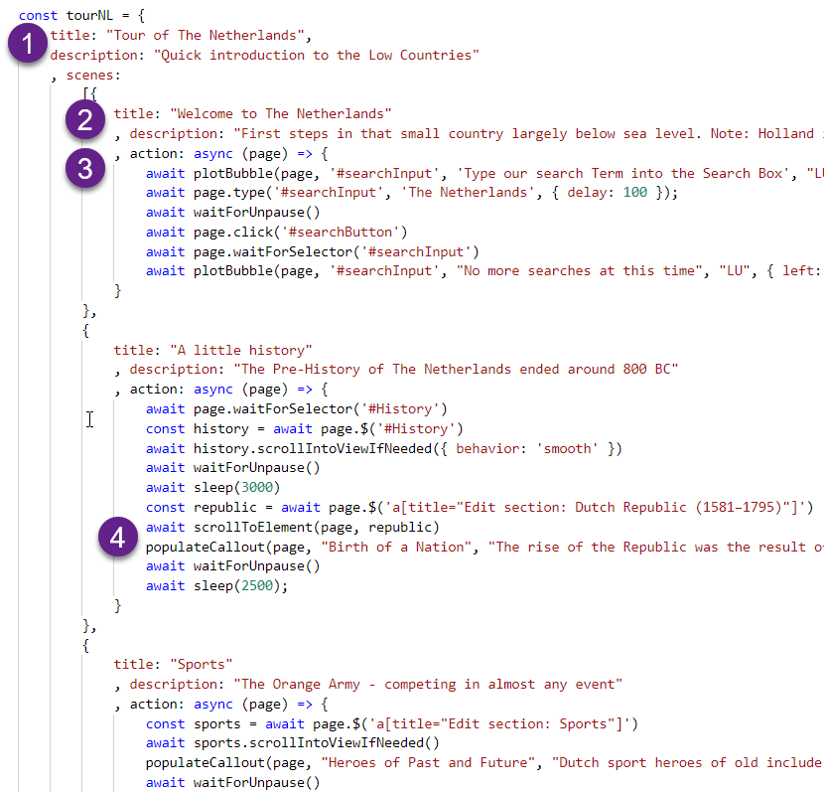
Playwright scenarios – Implementation Details
Scenarios are defined in an object structure
scenario – title and description
acts – title, description and action (JS function)
Actions use helper functions
populateCallout
waitForUnpause
plotBubble
scrollToElement
page.bringToFront

Slide 37
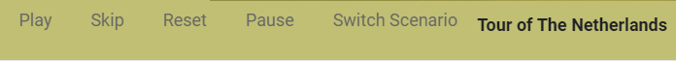
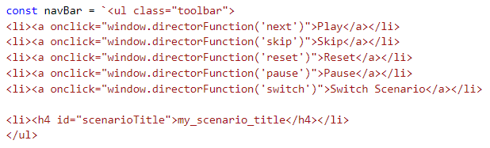
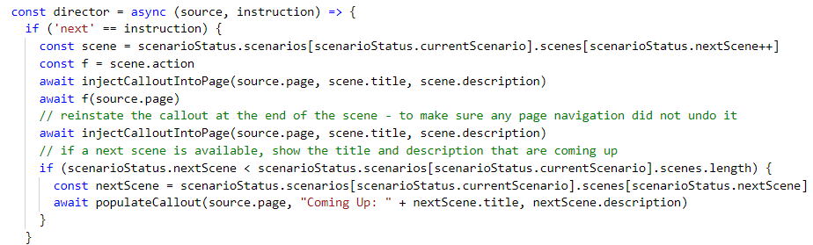
Playwright scenarios – Implementation Details
Toolbar handles user actions and passes them to the director() function
The director() function invokes actions – the NodeJS functions that do the actual work in each act
these functions use Playwright and execute code in the browser context – against UI, DOM and JS

Slide 38
Add Toolbar for scenario playing to any Web Application
scenario related user events trigger the director(). It can change the current scenario or set or reset the next act; it can toggle the pause status; and it can execute the action function to play the upcoming act
callout and bubble help are added to DOM (style, script and HTML) through Playwright
Web Application
function director()
scenarioStatus
scenarioStatus keeps track of current scenario, next act and pause/unpause
function directorFunction
scenarios.json
a scenario has a title and a description and consists of acts; each act has a title and description as well as a JS function that manipulates the browser (and beyond)
Toolbar with Play, Skip, Pause, Reset and Switch scenario. Actions trigger function director through proxy window.directorFunction

Slide 39




Generate PowerPoint report from a Playwright tour of Web pages
Run Playwright actions, visit pages, take screenshots and save images, gather data. Using PptxGenJS: create a new powerpoint document, create slides, add screenshots and images, write text, create charts; save PowerPoint document.
Web Application
function showProducer()
npm module PptxGenJS

Slide 40
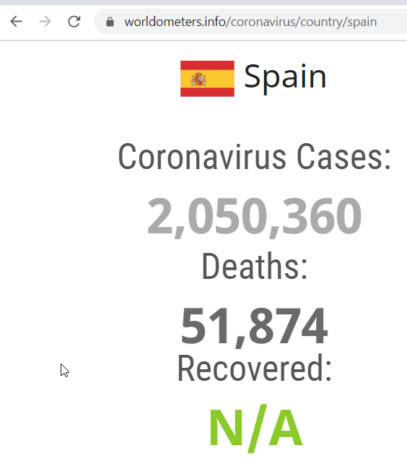
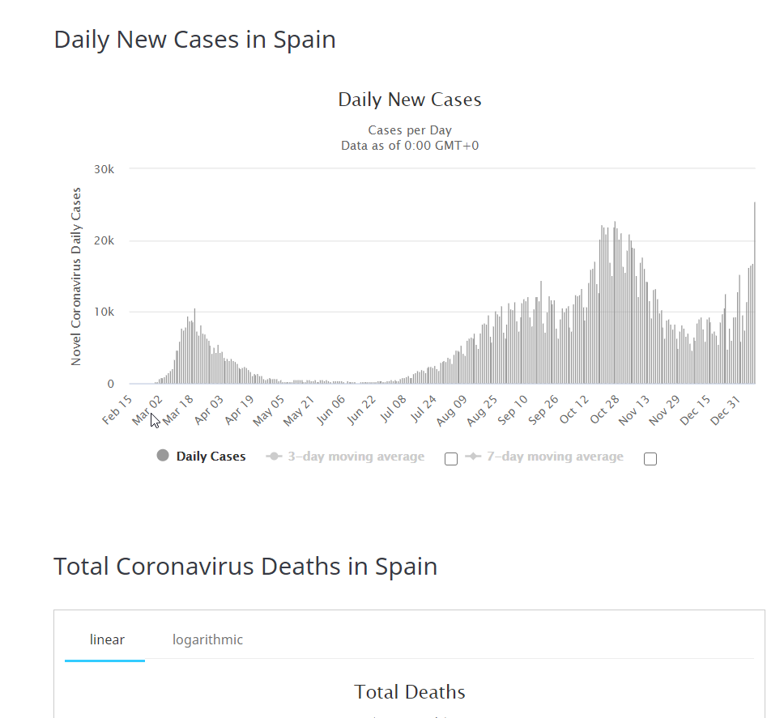
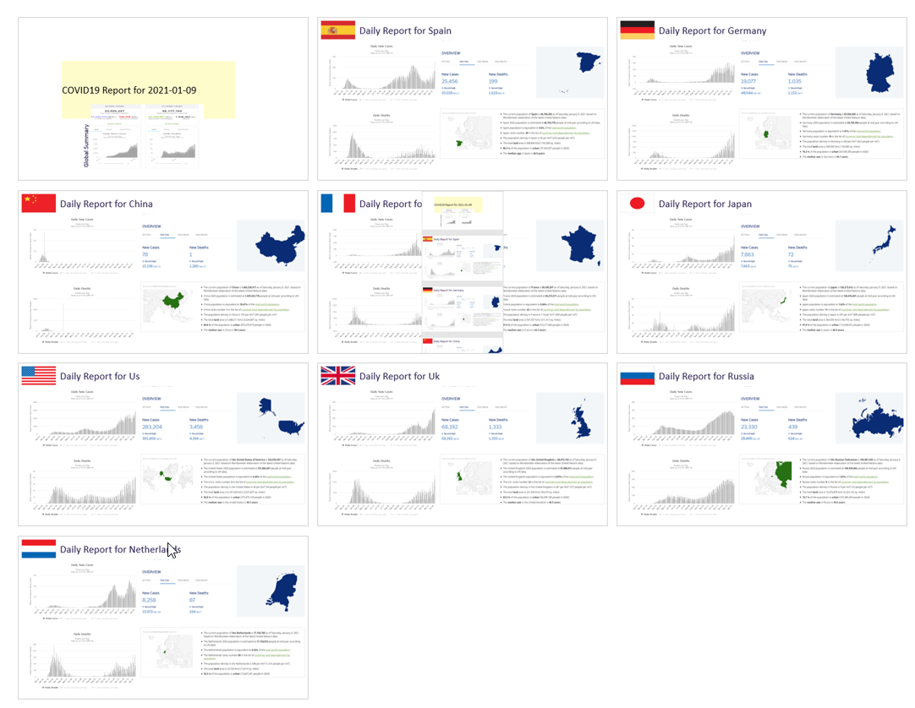
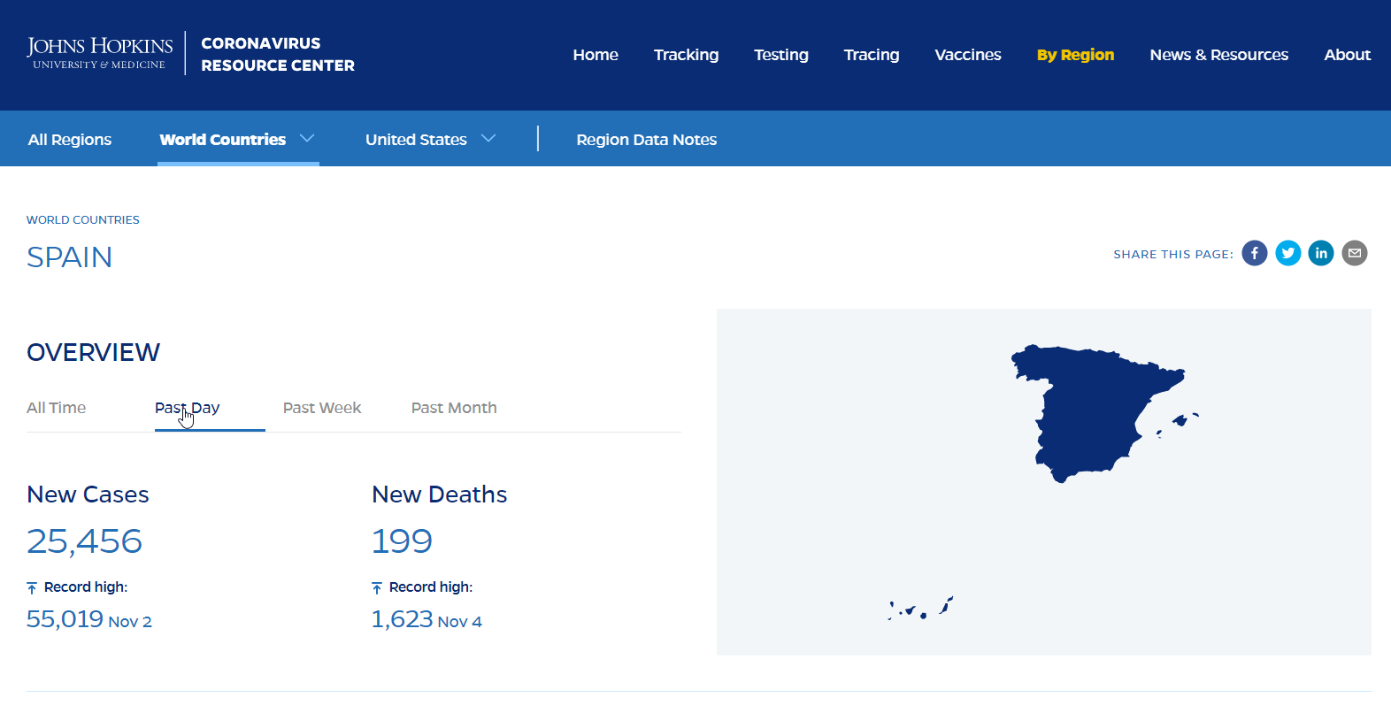
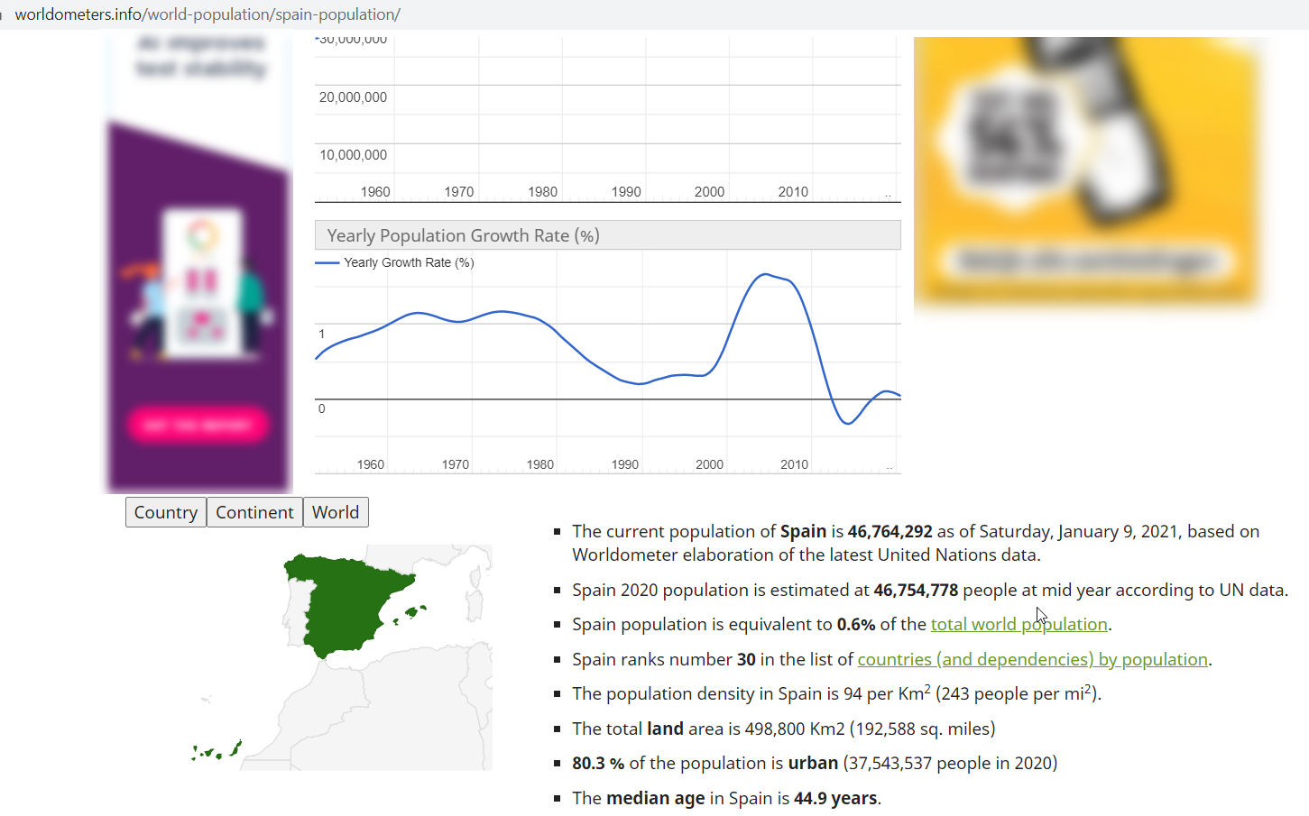
Generate Daily COVID-19 PowerPoint report
Web Application
function showProducer()
npm module PptxGenJS

Slide 41
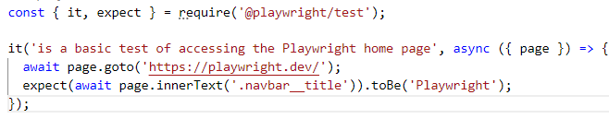
Playwright Test Runner – for running automated “unit” tests
Playwright can be used to execute tests
embedded in Test Runners such as AVA, Mocha, Jest (see jest-playwright) and Jasmine
using its own Test Runner – using Jest/Jasmine style test syntax
A test based on Playwright performs actions through a browser (just like a human user would) and verifies the success of these actions
In code, such a test wraps regular Playwright code in a “test wrapper” and uses expect conditions on values returned by Playwright
The test runner allows running tests on selected browsers (WebKit, Firefox and Chromium)

Slide 42

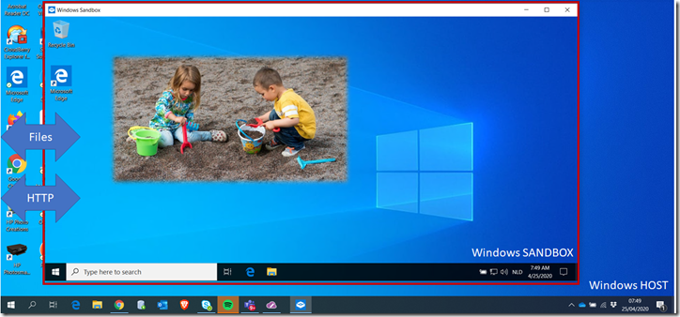


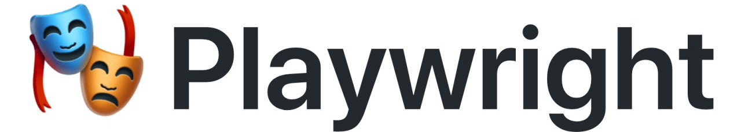

Quick Get Going on Windows: in a Sandbox
source code
Part of Windows 10 – 1903 and later (installed on my laptop in mid April 2020)

Slide 43
Windows Sandbox
Part of Windows 10 – 1903 and later (installed on my laptop in mid April 2020)

Slide 44
Windows Sandbox is a new lightweight desktop environment tailored for safely running applications in isolation.
Part of Windows – everything required for this feature ships with Windows 10 Pro and Enterprise. No need to download a VHD!
Pristine – every time Windows Sandbox runs, it’s as clean as a brand-new installation of Windows
Disposable – nothing persists on the device; everything is discarded after you close the application
Secure – uses hardware-based virtualization for kernel isolation, which relies on the Microsoft’s hypervisor to run a separate kernel which isolates Windows Sandbox from the host
Efficient – uses integrated kernel scheduler, smart memory management, and virtual GPU

Slide 45
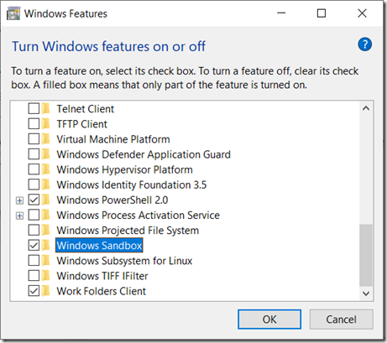
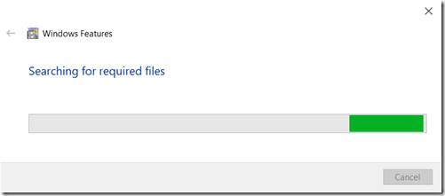
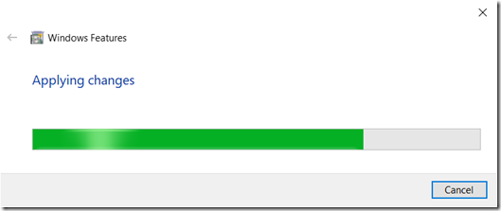
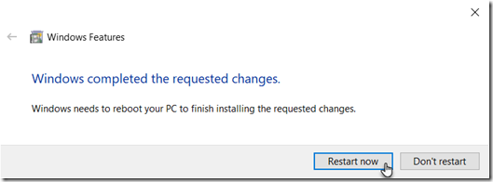
How to get going
You need Windows 1903 (build 18305) or later
Turn Windows Sandbox feature on

Slide 46
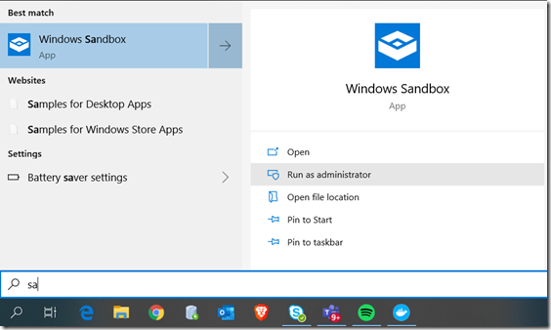
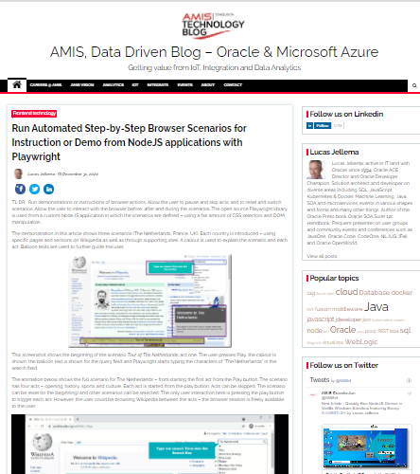
How to get going (2)
After the reboot:
Run a Sandbox
Create PS1 script to install Scoop, Git, Node and VS Codium
Run script
Execute commands to git clone repo, install Playwright and run scenarios
https://technology.amis.nl/frontend-technology/run-automated-step-by-step-browser-scenarios-for-instruction-or-demo-from-nodejs-applications-with-playwright/

Slide 47

Google Translate UI wrapped as Oracle Function
{ "sourceLanguage":"en" , "targetLanguage":"nl" , "text":"Hello Beautiful New World"
}
Web Application
Project Fn
HotWrap
{ "translation":"Hallo mooie nieuwe wereld"
, "sourceLanguage":"en" , "targetLanguage":"nl" , "text":"Hello Beautiful New World"
}

Slide 48

Google Translate UI wrapped as Oracle Function
Inject Fn context settings, security principal and HTTP request Headers as environment variables, write body to standard input, Invoke “node app.js”, return standard output as response
zenika/alpine-chrome:with-playwright
Web Application
Project Fn
HotWrap
Read request body from standard input, read environment variables; write result to standard output (console.log)
Regular Fn function call – using headers and body
fnproject/hotwrap

Slide 49
Generic approach for Fn Function on top of custom Docker Container Image and wrapped with Hotwrap
Inject Fn context settings, security principal and HTTP request Headers as environment variables, write body to standard input, Invoke “node app.js”, return standard output as response
any exotic or mundane image
Project Fn
HotWrap
Read request body from standard input, read environment variables; write result to standard output (console.log) ; the application can be implemented in Node, shell, Go, Java, Python, … or combination of all of the above
Regular Fn function call – using headers and body
fnproject/hotwrap

Slide 50
Dockerfile for custom container image
# community container image for alpine based headless chrome image with playwright chromium installed
FROM zenika/alpine-chrome:with-playwright
# add the files that make up the Node application;
# package.json can be included – however, it should not contain dependency on playwright
ADD app.js /usr/src/app/src
ADD translate.js /usr/src/app/src
# Install hotwrap binary in the container
COPY --from=fnproject/hotwrap:latest /hotwrap /hotwrap
# The command that runs the process/application in the container that does the actual work
CMD "node /usr/src/app/src/app.js"
# hotwrap is the executable in the container;
# it invokes the CMD and passes any input (sent in the Fn request) on the standard input
# any output written to standard output while executing the CMD is returned by hotwrap in the Fn response
ENTRYPOINT ["/hotwrap"]

Slide 51
Node application interacting with Hotwrap
// require the NodeJS module that does the real work
const { translate } = require("./translate");
// expected input format: {"sourceLanguage":"en", "targetLanguage":"nl", "text":"Hello World"}
const f = async (input) => {
const i = JSON.parse(input)
const translation = await translate(i.text, i.sourceLanguage, i.targetLanguage)
return JSON.stringify(Object.assign({"translation": translation}, i))}
// use readline to read from standard input (where hotwrap provides the body from the function request)
const readline = require('readline');
const rl = readline.createInterface({ input: process.stdin, output: process.stdout, terminal: false });
// readline event handler – read one line that contains the function request body and process it
rl.on('line', function (line) {
// function is asynchronous; when the result is available, the promise resolves
f(line).then((value) => {
// provide the result from the function call as standard output
console.log(value);
})
})
translate.js
HotWrap

Slide 52
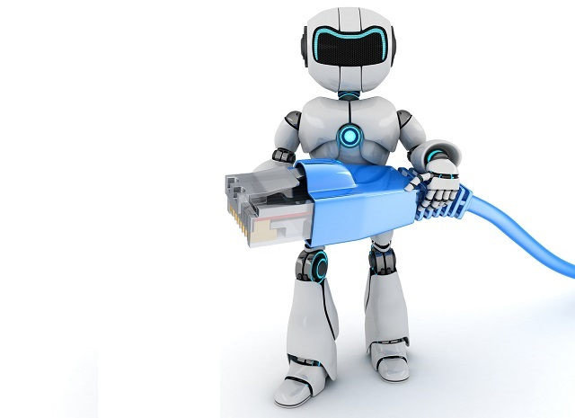
Notes
Integrate with test frameworks (and its own Test Runner)
Mocha, Chai, Jest, CodeceptJS, Jasmine, …
Run as Serverless Function
AWS Lambda, Azure Function, Heroku, Oracle Functions, …
Integrate in CI/CD Pipeline

Slide 53
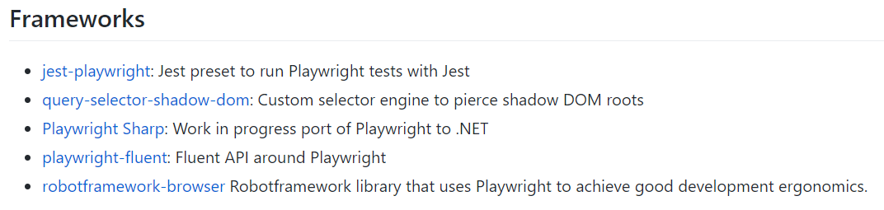



Tools & Ecosystem

Slide 54
The End (or rather: a beginning)
sources: bit.ly/REAL-playwright

